Slide 1
LF Edge：Open Source to Enable 5G, IoT and AI Development
Yachen Wang
General Manager of Tencent Cloud Network
Board Member of LF Edge
Board Member of LoRa Alliance

Slide 2
1
LF Edge
Edge Computing in Linux Foundation

Slide 3
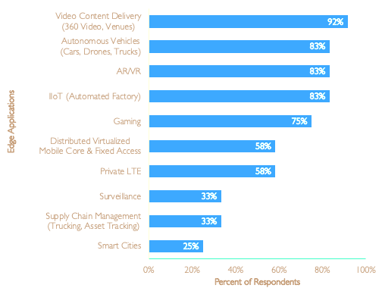
Edge Killer Apps: Non-traditional video + Connected things that move
Q: What are the top 5 (or more) edge services?
Many metro locations within 20ms of parts of populations…
Telecoms have advantage of COs, cell sites, cell backhaul aggregation, fixed backhaul, street cabinets, etc. much closer to users
Edge enhanced apps include many elements: natural language, facial recognition, immersive experience, swarming
Big (too much) bandwidth top driver

Slide 4







LF Edge – New umbrella for Edge Projects
Projects: Akraino, EdgeX, Home Edge, EVE, Covering IOT, Telco, Cloud and Enterprise Scenarios
Edge Computing Glossary
Application Interoperability
Interoperability between IoT devices and applications
API coordination for intelligent orchestration of IoT edge workloads
Edge OS
OR
OS
Lightweight real-time
hypervisor
Hypervisor
Application and network provisioning and orchestration
Device Provisioning
Trusted device onboarding across dynamic supply chain via Intel-Arm collaboration
Infrastructure
Device Edge
Control Edge
Gateways (Thin and Thick)
Industrial/ Telco Radio Edge/HCI
MDC Edge
On-Prem DC Edge
Telco/Cloud Edge

Slide 5
LF Edge – 4 Edge Projects
Application and Network Provisioning and Orchestration
Interoperability Between IoT Devices and Applications
Edge Framework for Smart Home
OS and Hypervisor for Enterprise on-premises Edge Device
Loosely-coupled microservices Interoperability framework
HW-, OS- and Protocol-agnostic
Variety of cloud platforms
There Release published, Fourth release in June 2019
5G、IoT use cases
Blueprints model
20 Blueprints
Release 1 on June 2019
Dynamic device/service discovery
Distributed machine learning
Release Alpha version in 2019 June , and 1.0 version in September 2019
Hypervisor
Provide users APIs that enable new levels of control and visibility to on-premises device operations

Slide 6
2
TSEC
Tencent Smart Edge Connector

Slide 7









Edge Computing enables 5G, IoT and AI for industries
Scenarios
Problems & Requirements
Technologies
Higher network bandwidth and lower latency to enable service into edge cloud
Reduce the device cost, e.g., cloud gaming
Improve industry efficiency, e.g. intelligent medical, smart office
5G acceleration: Slice/QoS
Security
Rendering in Edge
AI in Edge
IoT capability enhancement
Cloud Gaming
Smart Office
Industry
Internet
Connected Car
Intelligent
Medical
AR/VR
Live Broadcasting
HD Video

Slide 8




Why TSEC?
TSEC：Tencent Smart Edge Connector
To Support Network PaaS Bridging 5G/IoT and Services
Mobile Traffic Offloading
Network Acceleration
Edge Traffic Forwarding
Across Edge/DC
Tunneling
IoT Access & Control
Security
Software defined Routing
Traffic to Edge
Different Service Scheduling Adaptation
Low Latency
High Performance
LB
Traffic Statistics
IoT Data Access
Local Data Handling
Edge & Cloud Coordination
UL/DL BW Adjustment
On-demand Acceleration
Rate adaptive optimization

Slide 9










TSEC: PaaS for edge network
Cloud, Gaming, Video…
Telco Cloud
TSEC
Network Collaboration
Mobile QoS
Kit
Mobile Edge Kit
Mobile Slice Kit
IoT Edge Kit
IoT Core Kit
……
Edge
Cloud
TSEC
Access
Mobile Edge GW
IoT Edge
GW
LoRa GW
5G/4G
Things Connected
Mobile Users
IoT Device
LoRa Device

Slide 10





TSEC Mobile Edge/Slice Kit/GW for 5G
Central
Cloud
MEC APP/PaaS
Flexible traffic offloading control
High performance and intelligent forwarding
Connection quality guarantee(Slicing/QoS)
Security
Load balancing
TSEC Mobile Edge/Slice Kit
Edge PaaS/APP
Management and orchestration
5G
CP
Edge App
Edge PaaS
Service Framework
Cloud Gaming
Rending
Service Registry
Location
Edge
Cloud
Edge Traffic
TSEC Edge GW
HD Video
Message Communications
5G UP
AI
……
……
……
4G/5G
Bare-metal
K8S + Container
OpenStack + KVM
MEC
MEC Server
Route/Switch
GPU/FPGA …
TSEC Mobile Edge capabilities

Slide 11
TSEC Edge/Slice Kit/GW Open Source Framework Proposal
-A PaaS running on VM or Container or Bare-metal
EPC/
5GC
TSEC 边缘组件
OSS
Orchestration
Edge GW
TSEC Edge GW
5G NSA/SA Termination
Traffic offloading
L4LB, L7LB
Traffic management
Routing, NAT…
Application LCM
OAM Agent
Edge UPF/SGW
Broadcast
OPENNESS
VPP
F-Stack
Video
DPDK
Gaming
MEC
infrastructure
Bare-metal, K8S + Container, OpenStack/StarlingX + KVM, IEC
X86/ARM Server
Route/Switch
GPU/FPGA …

Slide 12
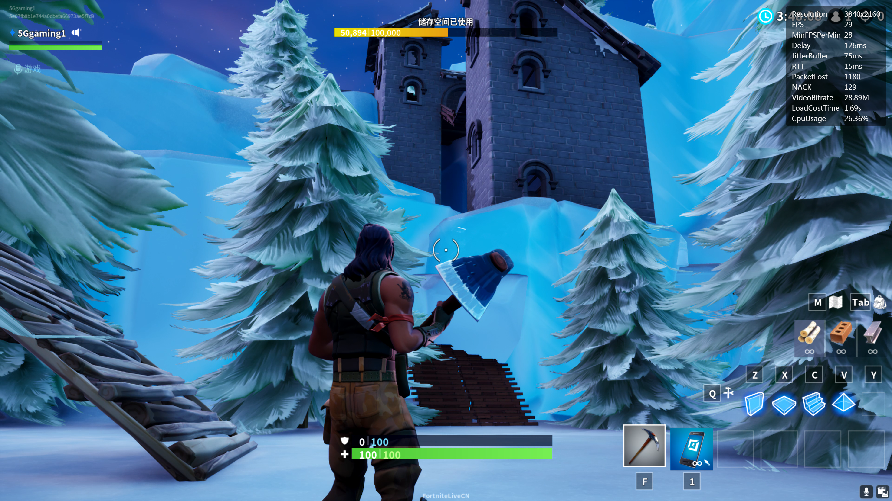
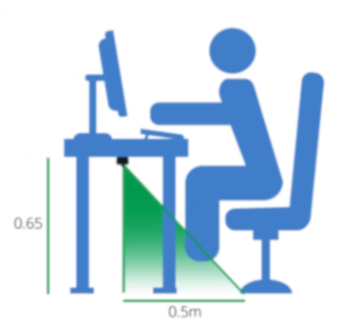
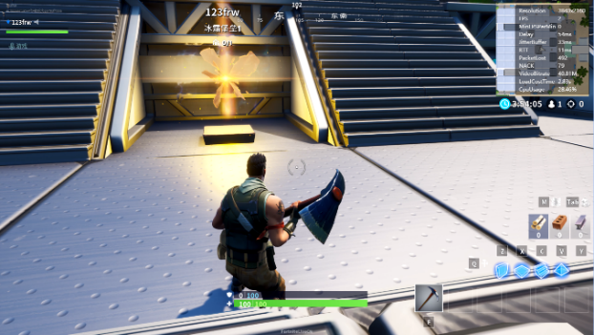
TSEC Open Source and Verification
5G Cloud Gaming
IoT Smart Office
5G
5G
2019/06：5G MEC/Slice and AIoT Blueprint Proposal to LFE Akraino Project
2019/06：LAB verification for 5G TSEC, and Cloud Gaming demonstration in Shanghai MWC
2019/05：AIoT in Smart office for Smart Meeting Room prototype shown in Tencent Global Digital Ecosystem Summit

Slide 13

Tencent 5G and IoT
Open & Cooperation

